Slide 1

QER 11100
QER: MERAKES EAST PROJECT SF216608C002.07 – Intermittent superficial scratches

Slide 2
Pipe section / Details
Item | Traceability / identification
Project number | SF216608C002
Project name | MERAKES EAST PROJECT
Pipe section | SF216608C002.07
ST number | ST254.72048
Affected layer / equipment | Zeta pressure vault spiraling
Length affected | 196.2m until 197.2m on pipe.
Drawing number / MP code / STA / Dimension | ZETA 12, FI 11(MP746)

Slide 3
Overview of anomaly
Problem Description :-
During the zeta spiraling of MERAKES EAST PROJECT SF216608C002.07 (ST254.72048), intermittent superficial scratch due to roller mark on the zeta wire was detected at start length 196.2m until 197.2m on pipe.
The details of measurement are as per below.
- Depth: 25um
Root Cause :-
The defect was generated due to wear of roller P.5 table 2.
Problem Handling:-
According to project acceptance criteria CD_216608C002_str25472048_TR01-09_rev0_An_Pressure vault, the maximum allowable criteria for the depth of surface defects is 100um and for the maximum upsetting is 50um. Thus, this defect was accepted as it is.

Slide 4
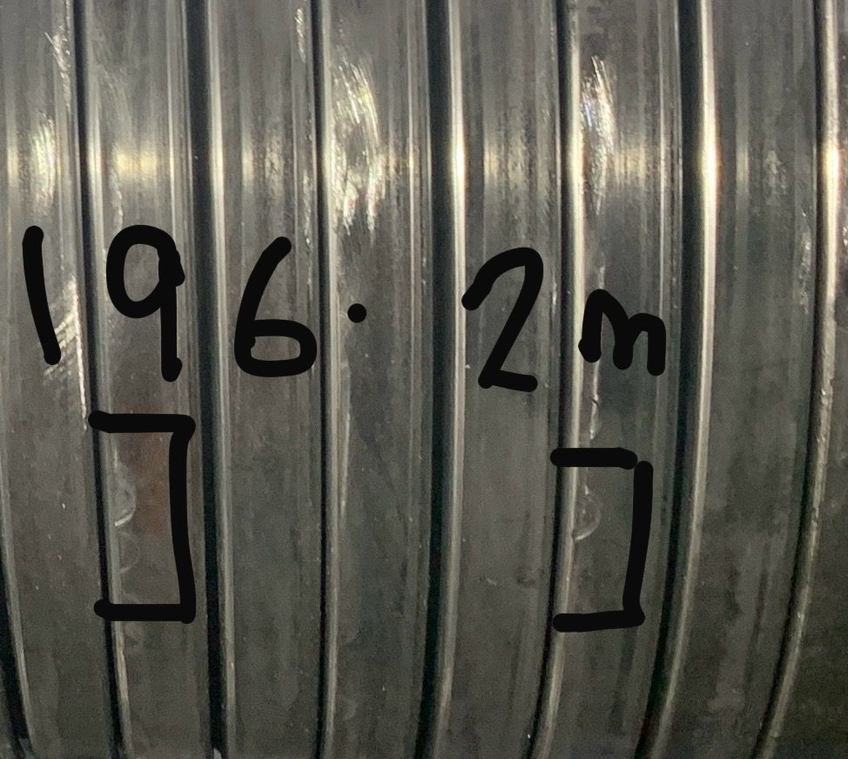
DEFECT PHOTOS
Figure 1 : Intermittent superficial scratch due to roller mark on the zeta wire was detected at start length 196.2m until 197.2m on pipe.

Slide 5

THANK YOU

